Slide 1
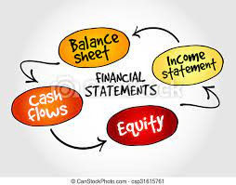
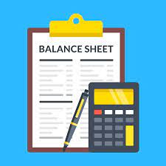
Corporate Financial statements
Part 1- Balance sheet

Slide 2

Learning outcomes
Examine the financial statements in the light of the current regulatory framework
Develop skills to analyze corporate financial statements and disclosures

Slide 3
Quick Revision
Equity ₹ 90,000 Liabilities ₹ 60,000 Profit of the year ₹ 20,000. Then total assets will be : (a) ₹ 1.70,000 (b) ₹ 1,50,000 (c) ₹1,10,000 (d) ₹ 80,000

Slide 4
POLL
Financial statements disclose : (a) Monetary information (b) Qualitative information (c) Non-monetary information (d) All the above
Notes:
(a) Monetary information

Slide 5
Introduction
Ind AS 1 is a basic standard, which prescribes the overall requirements for the presentation of general purpose financial statements, i.e. components of financial statements
The standard prescribes the minimum disclosures that are to be made in the financial statements and explains the general features of the financial information
.

Slide 6
Components of financial statements
Balance Sheet
Statement of Changes In Equity
Statement of Profit & Loss
Cash Flow statement
Notes forming part of accounts
Profit & Loss
Other Comprehensive Income
Other Comprehensive Income :
It is a part of the Statement of Profit & Loss
It is used only for recognition of notional and unrealized gains
On Actual realization/certainty, the balances transferred to Profit & Loss
Revaluation reserve, Actuarial gain or losses are few examples

Slide 7
The objective of financial statements
To provide information about the financial position, performance and cash flows of an entity that is useful to a wide range of users in making economic decisions.
To show the results of the stewardship of management (i.e., accountability for the resources entrusted to it.)

Slide 8
Purpose of Financial statements
Financial Position | Financial Performance | Changes in Financial Position
Affected by: -Economic resources controlled – Financial structure – Liquidity and solvency – Capacity to adapt to changes | In Particular profitability To predict capacity to generate cash flows from the existing resource base To form judgments about effectiveness with which additional resources might be employed | To assess investing, financing and Operating activities To assess ability to generate cash and cash equivalents and needs to utilize those cash flows.
Balance Sheet | Statement of Profit and Loss | Statement of Cash Flow

Slide 9
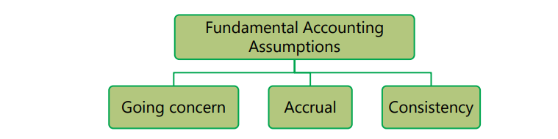
Basis of preparation

Slide 10
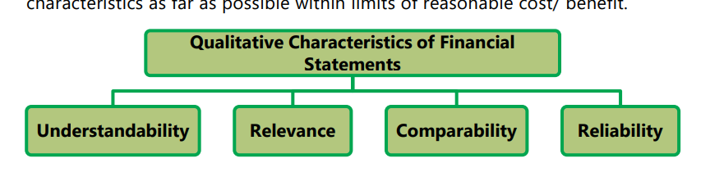

Slide 11
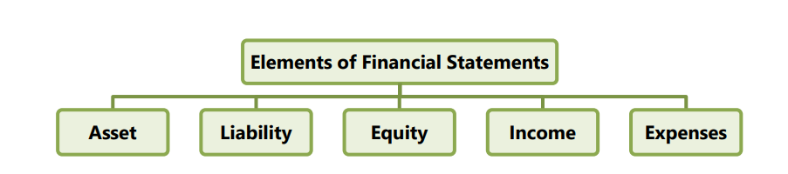

Slide 12
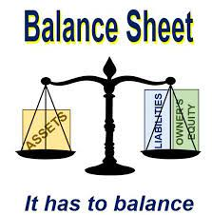
Balance sheet

Slide 13
Meaning
The balance sheet displays the company’s total assets and how the assets are financed, either through either debt or equity. It can also be referred to as a statement of net worth or a statement of financial position. The balance sheet is based on the fundamental equation: Assets = Liabilities + Equity.

Slide 14
Key Components:
Assets and liabilities are categorized broadly into financial and non
financial on the face of balance sheet
Presentation of assets and liabilities in decreasing order of liquidity
(i.e. Liquidity based balance sheet)

Slide 15
The Ministry of Corporate Affairs (MCA) has amended Schedule III of Companies Act 2013 (“Act”) on 24 March 2021 with an objective to increase transparency and provide additional disclosures to users of financial statements.
These amendments are effective from 1 April 2021 onwards.

Slide 16
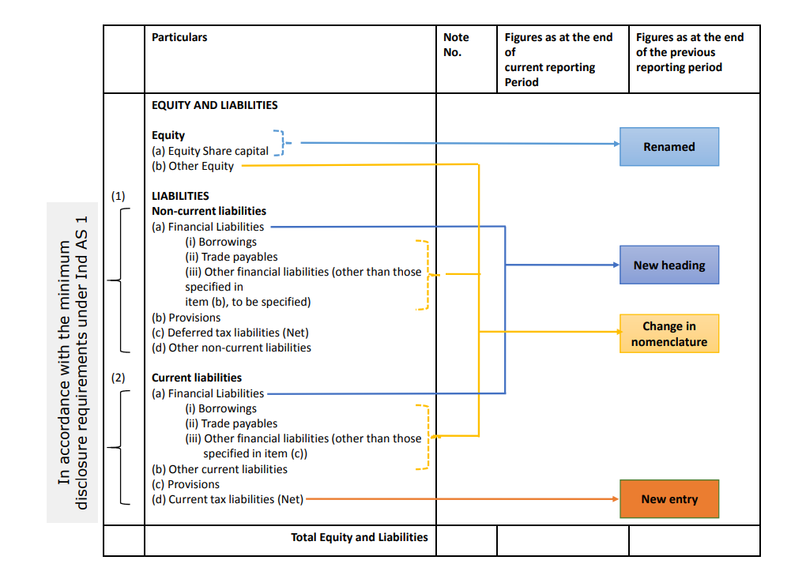

Slide 17
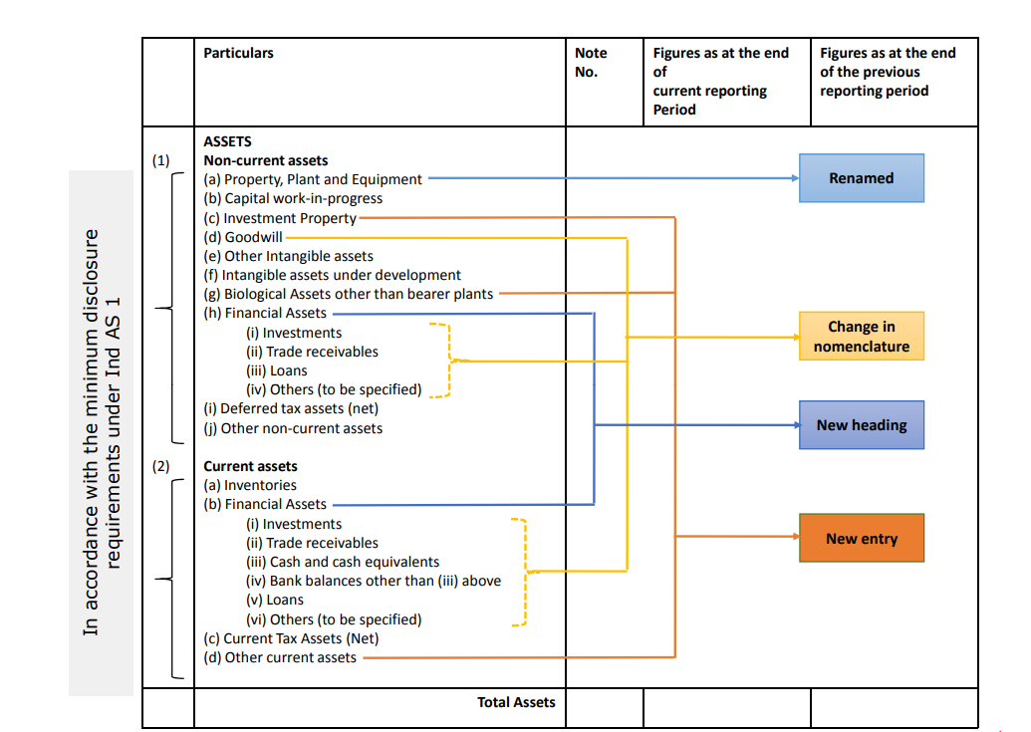

Slide 18
Balance Sheet - Amendments
Following line items to be shown under equity on the face of the balance sheet:
i) Equity share capital, and
ii) other equity
Word “Property, Plant and Equipment” to be used instead of “Tangible Assets”.
Provision word to be used . However the Short Term Provisions/ Long Term Provisions will still be shown in Current/ Non Current Liabilities.

Slide 19
Balance Sheet - Amendments
Following to be shown separately on the face of the balance sheet :
Goodwill
Investment Property
Intangible assets under development
Biological Assets other than bearer plants
Financial Assets( Bifurcated into (i) Investments, (ii) Trade receivables, (iii) Loans, (iv) Others )
Financial Liabilities ( Bifurcated into (i) Borrowings, (ii) Trade payable, (iii) Other financial liabilities ).

Slide 20
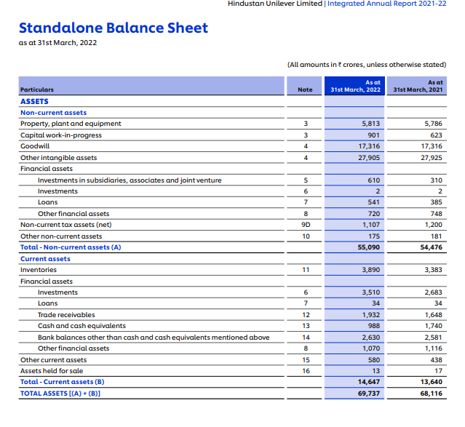

Slide 21
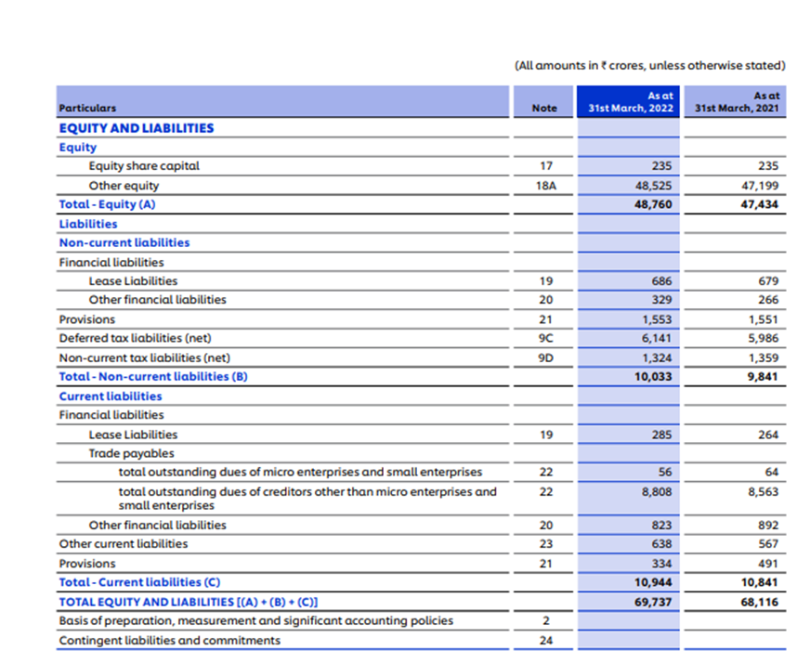
Notes:
For details refer page 137-https://www.hul.co.in/files/92ui5egz/production/8a1b3f103408328781a6ebf434b8e5172e4bfc91.pdf

Slide 22
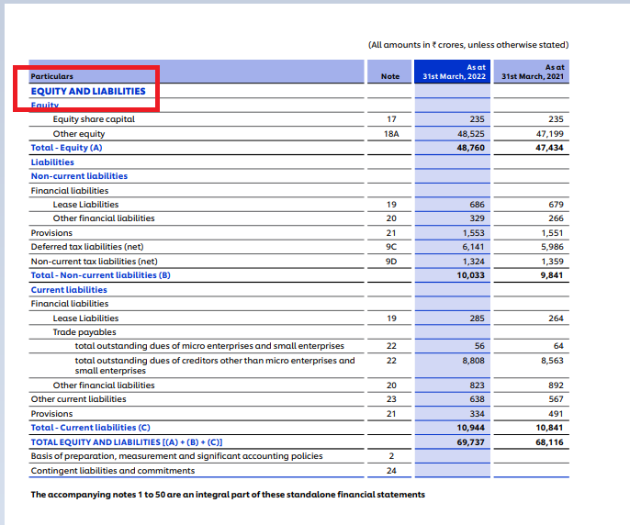
Equity
“Equity Share Capital” comprises
Only equity share capital.
Preference shares are excluded

Slide 23
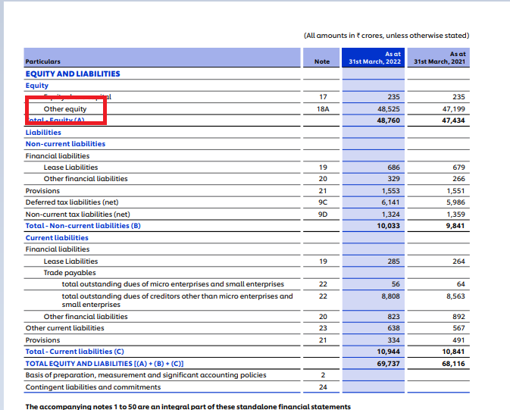
Other Equity
“Other Equity” includes –
Reserves & Surplus
Equity Component of Compound Financial Instruments like Share Application Pending Allotment.
Other Comprehensive Income (OCI)
Notes:
Reserves and Surplus shall be classified as:
(a) Capital Reserves;
(b) Capital Redemption Reserve;
(c) Securities Premium Reserve ;
(d) Debenture Redemption Reserve;
(e) Revaluation Reserve;
(f) Share Options Outstanding Account;
(g) Other Reserves–(specify the nature and purpose of each reserve and the amount in respect thereof);
(h) Surplus i.e., balance in Statement of Profit and Loss disclosing allocations and appropriations such as dividend, bonus shares and transfer to/ from reserves, etc.;

Slide 24
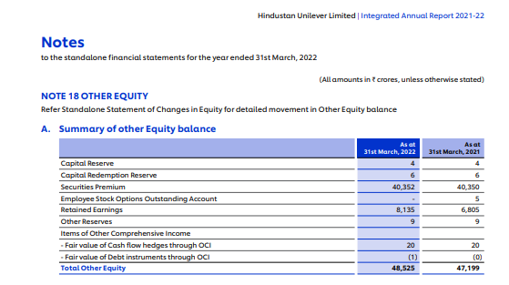
Notes:
For details refer page 168-https://www.hul.co.in/files/92ui5egz/production/8a1b3f103408328781a6ebf434b8e5172e4bfc91.pdf

Slide 25
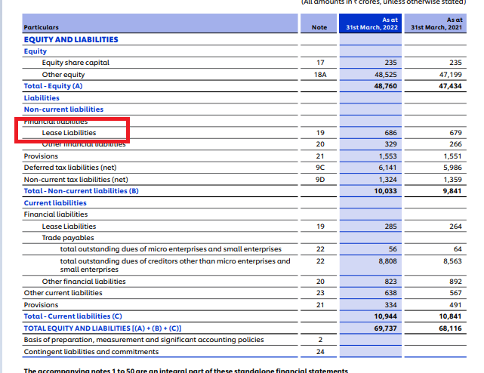
Lease Liabilities
Ind AS 116 defines a lease as a contract, or part of a contract, that conveys the right to use an asset (the underlying asset) for a period of time in exchange for consideration.
Lessees have to recognize a lease liability reflecting future lease payments and a ‘right-of-use asset’ for almost all lease contracts

Slide 26
Poll
The reserve which is created for a particular (specific) purpose and which is a charge against revenue is called:
(a) Capital Reserve
(b) General Reserve
(c) Secret Reserve
(d) Specific Reserve
Notes:
(d) Specific Reserve

Slide 27
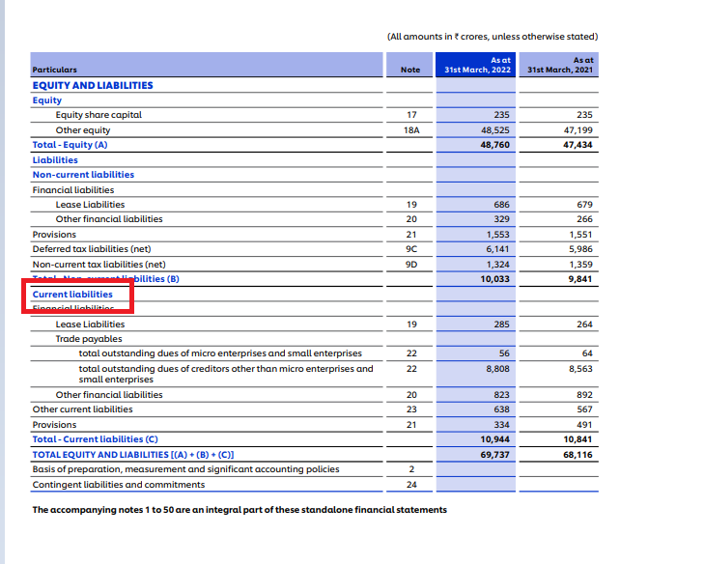

Slide 28
Current Liability
it expects to settle the liability in its normal operating cycle
it holds the liability primarily for the purpose of trading;
the liability is due to be settled within twelve months after the reporting period; or
no unconditional right to defer settlement of the liability for at least twelve months after the reporting period.
All other Liabilities are non-Current

Slide 29

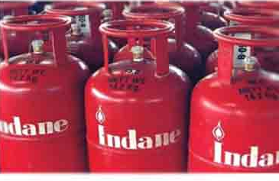
Analyse the situation-
A Gas Agency requires an amount to be deposited as security deposit, which is refundable when the gas connection is surrendered. How should the Gas Agency classify such deposits received, i.e., current or noncurrent?
Notes:
Although it is expected that most of the customers will not surrender
their connection and the deposit will need not to be refunded, but
surrendering of gas connection by the customer is a condition that is not
within the control of the entity. Hence the Gas Agency does not have an
unconditional right to defer settlement of the liability for at least twelve
months after the reporting period. Accordingly, the deposit will have to
be classified as current liability.

Slide 30
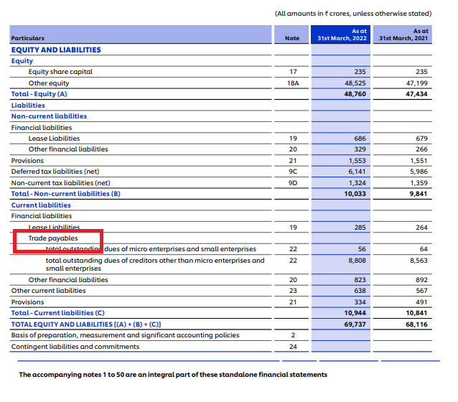
Trade Payables
Trade payables are obligations to pay for goods or services that have been acquired from suppliers in the ordinary course of business.
Trade payables are classified as current liabilities if payment is due within one year or less. If not, they are presented as non-current liabilities.

Slide 31
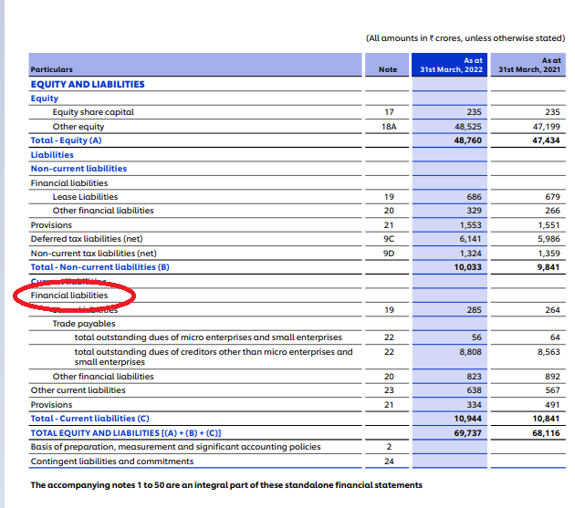
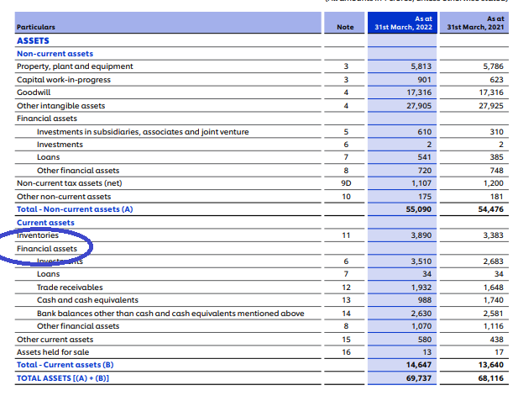
Financial Asset and Financial Liability

Slide 32
An entity shall recognize a financial asset or a financial liability in its balance sheet only when the entity executes the Contractual agreement involving the financial Instrument

Slide 33
Financial Asset
Cash
Financial Liability
Contractual obligation to deliver-
Equity instrument of another entity
Contractual right to receive cash, another financial asset from another entity
Cash & Another financials asset
Contract that will or may be settled in the entity's own equity instruments

Slide 34
Examples
Particular | Whether it is Financial Instrument? | Classification | Reason
Loans/Advances- Bank or Inter corporate
Y
Financial Liability
Financial liability as contractual obligation of the entity to pay cash to bank.(Para-11(a)
Cash
Financial Asset
A financial asset is any asset that is: (a) cash;
Cash
Y
Cash
Share of Subsidiary Companies
Y
Financial Asset
a contractual right to receive cash by way of dividend or at the time sale of the investment
Prepaid Expenses
N
N.A
There is no contractual obligation to receive the cash/ financial Asset. future economic benefit of the same is the receipt of goods and services

Slide 35
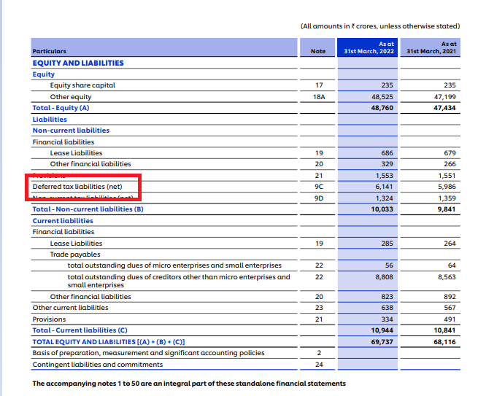
Deferred Tax
Deferred tax refers to income tax overpaid or owed due to the temporary differences between accounting income and taxable income.
It is part of the accounting adjustment and gets eliminated as the temporary differences are reversed over time.
It is recorded as a liability or asset in the balance sheet at the year-end.

Slide 36
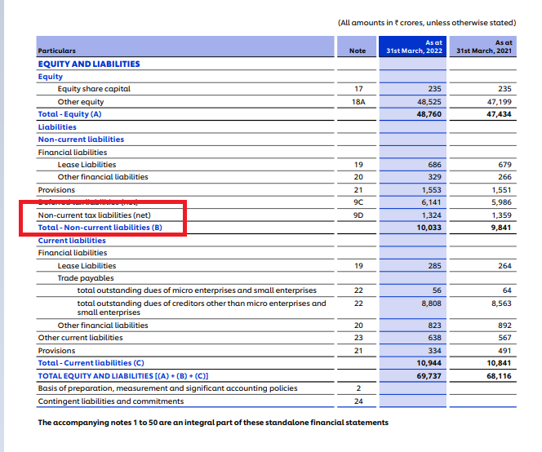

Current tax liabilities
Current tax liabilities (assets) for the current and prior periods are measured at the amount expected to be paid to (recovered from) the taxation authorities, using the tax rates (and tax laws) that have been enacted or substantively enacted by the end of the reporting period

Slide 37
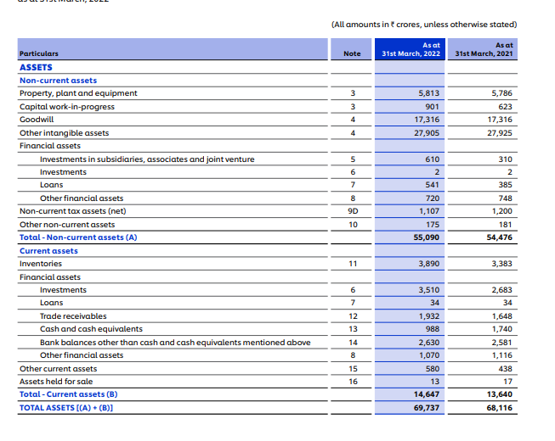
Assets

Slide 38
The assets of a business can be classified as :
(a) Fixed and Non-fixed Assets
(b) Tangible and Intangible Assets
(c) Non-Current and Current Asset

Slide 39
Current Asset
(a) it expects to realize the asset, or intends to sell or consume it, in its normal operating cycle;
(b) it holds the asset primarily for the purpose of trading;
(c) it expects to realize the asset within twelve months after the reporting period;
All other assets are classifies as Non – Current

Slide 40

Use your brain..
Inventory or trade receivables of Pluto Ltd are normally realized in 15 months. Should Pluto Ltd. classify such inventory/trade receivables as current ?
Notes:
Yes as operating cycle is of 15 months

Slide 41
Poll
The liability created by a business when it purchases coffee beans and coffee cups on credit from suppliers is termed a(n)
a. account payable.
b. account receivable.
c. revenue.
d. expense
Notes:
account payable.

Slide 42

Investment Property
Investment Property defines Investment Property as the property (land or a building—or part of a building—or both) held (by the owner or by the lessee as a right-of-use asset) to earn rentals or for capital appreciation or both, rather than for:
(a) use in the production or supply of goods or services or for administrative purposes; or
(b) sale in the ordinary course of business.

Slide 43

Biological Asset
A Biological asset is a living animal or plant. Examples of biological assets are sheep, Trees in a timber plantation, Dairy Cattle, Cotton plants, Tea bushes, Oil palms, Fruit trees, etc.

Slide 44

Additional Regulatory Information

Slide 45
Ratios
Following Ratios to be disclosed:-
(a) Current Ratio,
(b) Debt-Equity Ratio,
(c) Debt Service Coverage Ratio,
(d) Return on Equity Ratio,
(e) Inventory turnover ratio,
(f) Trade Receivables turnover ratio,
(g) Trade payables turnover ratio,
(h) Net capital turnover ratio,
(i) Net profit ratio,
(j) Return on Capital employed,
(k) Return on investment.

Slide 46
The company shall explain the items included in numerator and denominator for computing the above ratios. Further explanation shall be provided for any change in the ratio by more than 25% as compared to the preceding year.

Slide 47
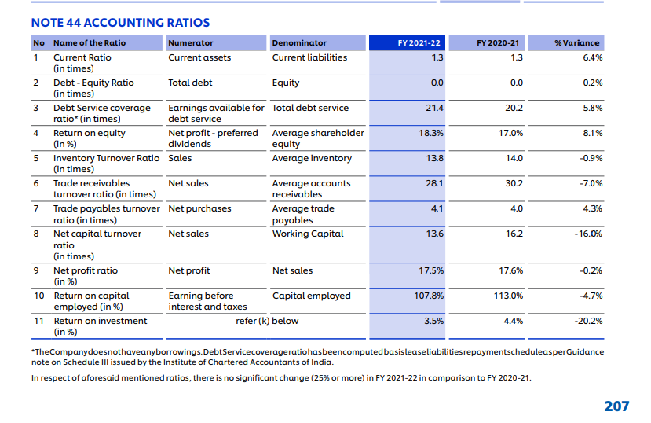

Slide 48
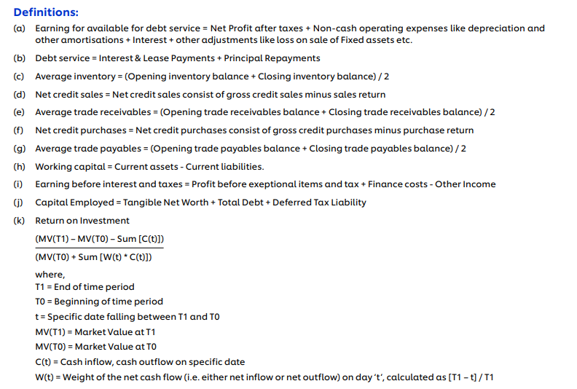

Slide 49
Details of Crypto Currency or Virtual Currency
Where the Company has traded or invested in Crypto currency or Virtual Currency during the financial year, the following shall be disclosed:-
(a) profit or loss on transactions involving Crypto currency or Virtual Currency
(b) amount of currency held as at the reporting date,
(c) deposits or advances from any person for the purpose of trading or investing in Crypto Currency/ virtual currency
Note:— Broad heads shall be decided taking into account the concept of materiality and presentation of true and fair view of financial statements.

Slide 50
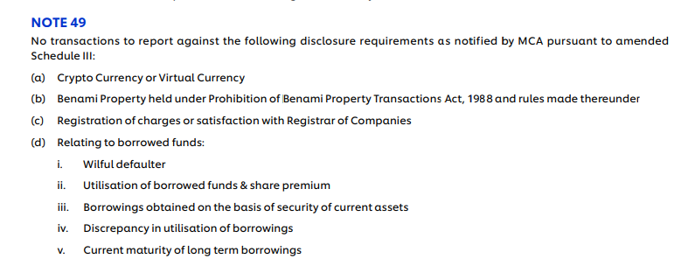

Slide 51

Poll
Provision for Provident Funds is shown in the Balance Sheet of a company under the head : (a) Reserves and Surplus (b) Non-current Liabilities (c) Provision (d) Contingent Liabilities
Notes:
(b) Non-current Liabilities

Slide 52
Contingent Liabilities are exhibited under the heading: (a) Fixed Liabilities (b) Current Liabilities (c) As a footnote (d) None of these
Notes:
Answer: (c) As a footnot

Slide 53
Rearrange the following items under assets according to Revised or New Schedule III:
Livestock
Loose Tools.
Goodwill
Trademarks
Bills Receivable
Debtors
Land
Leasehold
Stock-in-Trade
Stores and Spare Parts
Vehicles
Cash at Bank
Work in Progress(Machinery)
Interest accrued on Investment
Furniture
Advance to Subsidiaries
Cash in Hand
Plant
Deposits with electricity supply company.

Slide 54


